Slide 1
Activity Diagrams
What is Activity Diagram?
Purpose of Activity Diagrams..
How to Draw an Activity Diagram?
Where to Use Activity Diagrams?

Slide 2
What is Activity Diagram?
Activity diagram is basically a flowchart to represent the flow from one activity to another activity. The activity can be described as an operation of the system.
The control flow is drawn from one operation to another. This flow can be sequential, branched, or concurrent. Activity diagrams deal with all type of flow control by using different elements such as fork, join, etc

Slide 3
Purpose of Activity Diagrams:
The purpose of an activity diagram can be described as −
Draw the activity flow of a system.
Describe the sequence from one activity to another.
Describe the parallel, branched and concurrent flow of the system.

Slide 4
How to Draw an Activity Diagram?
Before drawing an activity diagram, we should identify the following elements −
Activities
Association
Conditions
Constraints
Activity diagram is drawn with the four main activities −
Send order by the customer
Receipt of the order
Confirm the order
Dispatch the order

Slide 5
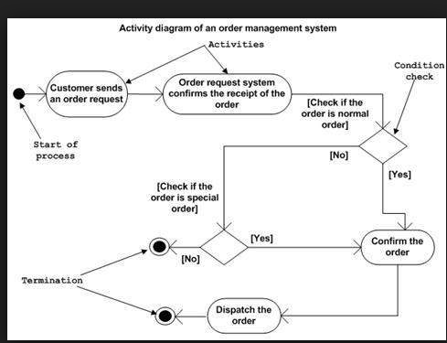
Activity Diagrams:

Slide 6
Where to Use Activity Diagrams?
Activity diagram can be used for −
Modeling work flow by using activities.
Modeling business requirements.
High level understanding of the system's functionalities.
Investigating business requirements at a later stage.

Slide 7
END

